Slide 1
The Horror of Internet Explorer 6 and Why It Should Die a Slow Bloody Death!
Presented by Michael “Spell” Spellacy & Larry Viezel

Slide 2
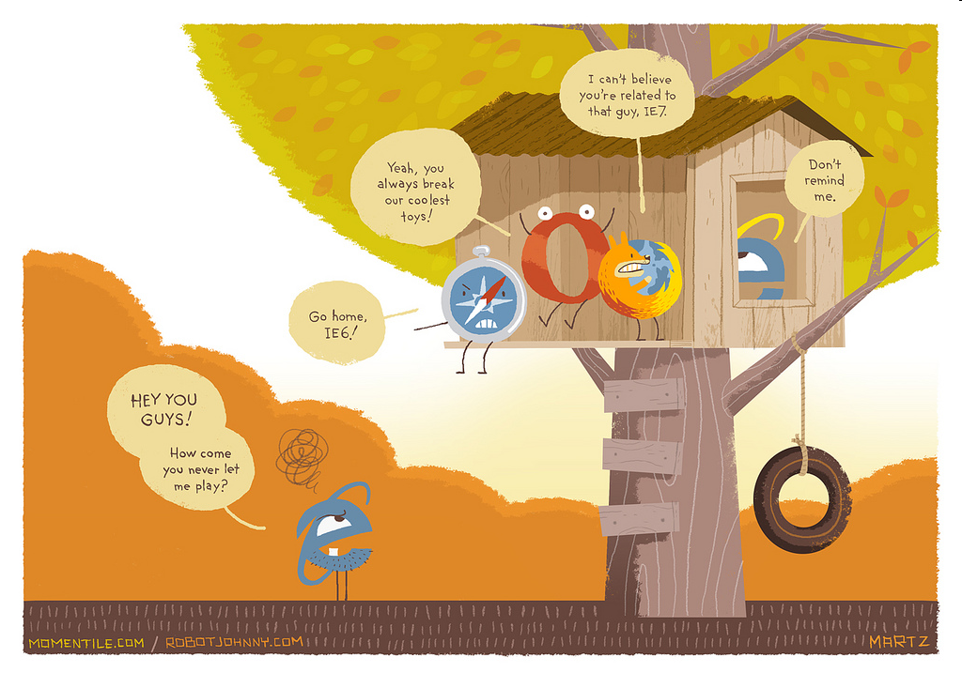

Slide 3

The Horror of Internet Explorer 6 and Why It Should Die a Slow Bloody Death!
Why IE6 Still Mostly Lives:
According to various sources, IE6 still commands 15 to 25 percent (possibly
inflated due to User Agents that intentionally misrepresent themselves) of the
browser market share. This is mostly due to the fact that Windows XP is still
widely used (which IE6 came installed on) and because of high use in corporate
environments.
A couple of reasons for it's prevalence in the corporate world include:
Complacency. Some IT Departments (the ones not worried about security, no doubt) see no need to upgrade.
Many internal web applications only work in IE6 (e.g., TMP’s Beacon, which has since been fixed)

Slide 4
The Horror of Internet Explorer 6 and Why It Should Die a Slow Bloody Death!
A Few Reasons Why Internet Explorer Must Be Put Out of It's Misery:
IE6 hinders web development - Applying hacks for a site to work in IE6 (CSS Hacks, PNG fixes, JavaScript forks, etc.) is wasting hundreds of development hours a year at TMP. Hours, that could be better spent doing more productive things like making a site more robust or accessible or spent goofing off on the internet when we should be working (Just kidding, Lynda!). Hacks also bloat our code, slow down performance, and generally create a bad user experience. If we are to “code for maintenance” (as Larry always recommends), then continued support for IE6 does not fit in with this methodology.
IE6 is bad for business - Sites like Google, Facebook, Digg, YouTube, and 37Signals (creators of Basecamp) have begun scaling down or dropping support for it. It is hard to build good applications that still support IE6. Even Microsoft recommends that you should upgrade!
HTML5 – It is on the horizon (and even works in some browsers now) but don't expect it to work in IE without a load of hacks!
Security – IE6 is riddled with security holes. Need I say more?

Slide 5
The Horror of Internet Explorer 6 and Why It Should Die a Slow Bloody Death!
What can we do to ease the pain?:
When possible, Account Directors and Project Managers should discuss this issue with their clients. If clients don’t know it’s a bad browser then they won’t upgrade (or bug their IT department to upgrade). It’s our responsibility to educate them. However, if the client absolutely needs IE6 support, we will, of course, still accommodate them (for now). If more ammunition is needed other than the ones outlined in this document then please feel free to contact me.
Verbiage in SOW has now been updated to reflect this very important issue. See Lynda Harden for more details!
Developers should be writing code that gracefully degrades (see Progressive Enhancement presentation for more information) on older browsers. The practice of using newer or standard features that current browsers support but which will not interfere with older browsers that do not support them.

Slide 6
The Horror of Internet Explorer 6 and Why It Should Die a Slow Bloody Death!
And finally, the most important reason for TMP to move away from IE6….

Slide 7

The Horror of Internet Explorer 6 and Why It Should Die a Slow Bloody Death!
Spell is tired of fixing it’s bugs and would like to see his kids more often!

